Slide 1
Discrete Mathematics
Logic - Conditional Statements

Slide 2
Conditional Statement/Implication
"if p then q"
Denoted p ⇒ q
p is called the antecedent or hypothesis
q is called the consequent or conclusion
Example:
p: I am hungry q: I will eat
p: It is snowing q: 3+5 = 8

Slide 3
Conditional Statement/Implication (continued)
In English, we would assume a cause-and-effect relationship, i.e., the fact that p is true would force q to be true.
If “it is snowing,” then “3+5=8” is meaningless in this regard since p has no effect at all on q
At this point it may be easiest to view the operator “⇒” as a logic operation similar to AND or OR (conjunction or disjunction).

Slide 4
Truth Table Representing Implication
If viewed as a logic operation, p ⇒ q can only be evaluated as false if p is true and q is false
This does not say that p causes q
“A false hypothesis implies any conclusion”
Truth table
Hypothesis Conclusion
p | q | p ⇒ q
T | T | T
T | F | F
F | T | T
F | F | T

Slide 5
The logical implication can be expressed in various ways, which are described as follows:
If p then q
If p, q
q when p
q only if P
q unless ~p
q whenever p
p is a sufficient condition for q
q follow p
p implies q
A necessary condition for p is q
q if p
q is necessary for p
p is a necessary condition for q

Slide 6
Examples where p ⇒ q is viewed as a logic operation
If p is false, then any q supports p ⇒ q is true.
False ⇒ True = True
False ⇒ False = True
If “2+2=5” then “I am the king of England” is true

Slide 7
Converse and contrapositive
The converse of p ⇒ q is the implication that q ⇒ p
The contrapositive of p ⇒ q is the implication that ~q ⇒ ~p
Example: What is the converse and contrapositive of p: "it is raining" and q: I get wet?
Implication: If it is raining, then I get wet.
Converse: If I get wet, then it is raining.
Contrapositive: If I do not get wet, then it is not raining.

Slide 8
Equivalence or biconditional
If p and q are statements, the compound statement p if and only if q is called an equivalence or biconditional
Denoted p ⇔ q
The only time that the expression can be evaluated as true is, if both statements, p and q, are true or when both statements, p and q are false
p | Q | p⇔q
T | T | T
T | F | F
F | T | F
F | F | T

Slide 9
Proof of the Contrapositive
Compute the truth table of the statement (p ⇒ q) ⇔ (~q ⇒ ~p)

Slide 10
p | q | p ⇒ q | ~q | ~p | ~q ⇒ ~p | (p ⇒ q) ⇔ (~q ⇒ ~p)
T | T | T | F | F | T | T
T | F | F | T | F | F | T
F | T | T | F | T | T | T
F | F | T | T | T | T | T

Slide 11
Tautology and Contradiction
A statement that is true for all of its propositional variables is called a tautology. (The previous truth table was a tautology.)
A statement that is false for all of its propositional variables is called a contradiction or an absurdity

Slide 12
Contingency
A statement that can be either true or false depending on its propositional variables is called a contingency
Examples
(p ⇒ q) ⇔ (~q ⇒ ~p) is a tautology
p ∧ ~p is an absurdity
(p ⇒ q) ∧ ~p is a contingency since some cases evaluate to true and some to false.

Slide 13
Contingency Example
The statement (p ⇒ q) ∧ (p ∨ q) is a contingency
p | q | p ⇒ q | p ∨ q | (p ⇒ q) ∧ (p ∨ q)
T | T | T | T | T
T | F | F | T | F
F | T | T | T | T
F | F | T | F | F

Slide 14
Logically equivalent
Two propositions are logically equivalent or simply equivalent if p ⇔ q is a tautology.
Denoted p ≡ q
Example of Logical Equivalence Prove: p ∨ (q ∧ r) ⇔ ( p ∨ q) ∧ ( p ∨ r)

Slide 15
Example of Logical Equivalence Prove: p ∨ (q ∧ r) ⇔ ( p ∨ q) ∧ ( p ∨ r)
Columns 5 and 8 are equivalent, and therefore, p “if and only if” q
p | q | r | q ∧ r | p ∨ (q∧r) | p ∨ q | p ∨ r | (p ∨ q) ∧ ( p ∨ r) | p ∨ (q ∧ r) ⇔ ( p ∨ q) ∧ ( p ∨ r)
T | T | T | T | T | T | T | T | T
T | T | F | F | T | T | T | T | T
T | F | T | F | T | T | T | T | T
T | F | F | F | T | T | T | T | T
F | T | T | T | T | T | T | T | T
F | T | F | F | F | T | F | F | T
F | F | T | F | F | F | T | F | T
F | F | F | F | F | F | F | F | T

Slide 16
Additional Properties (p ⇒ q) ≡ ((~p) ∨ q)
p | q | (p ⇒ q) | ~p | ((~p) ∨ q) | (p ⇒ q) ⇔ ((~p) ∨ q)
T | T | T | F | T | T
T | F | F | F | F | T
F | T | T | T | T | T
F | F | T | T | T | T

Slide 17
Additional Properties (p ⇒ q) ≡ (~q ⇒ ~p)
p | q | (p ⇒ q) | ~q | ~p | (~q ⇒ ~p) | (p ⇒ q) ⇔ (~q ⇒ ~p)
T | T | T | F | F | T | T
T | F | F | T | F | F | T
F | T | T | F | T | T | T
F | F | T | T | T | T | T

Slide 18
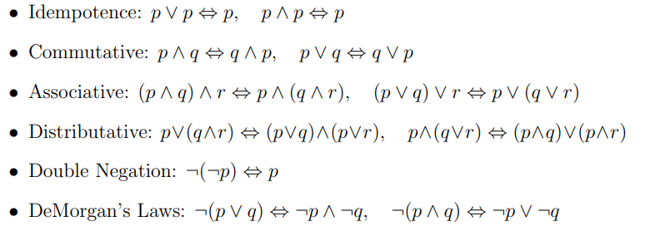
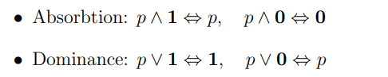
Laws Of Logic

Slide 19
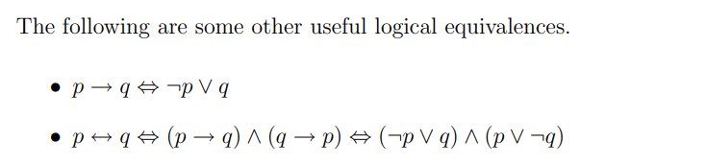
Two statements s1 and s2 are logically equivalent if s1 ↔ s2 is a tautology.
We use the notation s1 ⇔ s2 to denote the fact (theorem) that s1 ↔ s2 is a tautology, that is, that s1 and s2 are logically equivalent.
Notice that s1 ↔ s2 is a statement and can in general be true or false, and s1 ⇔ s2 indicates the (higher level) fact that it is always true.

Slide 20
Prove the following is a tautology:
¬q ∨ (p → q) ⇔ ¬q ∨ (¬p ∨ q) Known L.E.
⇔ ¬q ∨ (q ∨ ¬p) Commutative
⇔ (¬q ∨ q) ∨ ¬p Associative
⇔ 1 ∨ ¬p Known tautology
⇔ 1 Dominance

Slide 21
¬(¬p → q) ∨ (p ∧ ¬q) ⇔ ¬(¬¬p ∨ q) ∨ (p ∧ ¬q) Known L.E.
⇔ ¬(p ∨ q) ∨ (p ∧ ¬q) Double Negation
⇔ (¬p ∧ ¬q) ∨ (p ∧ ¬q) DeMorgan
⇔ (p ∧ ¬p) ∨ ¬q Dist’ve (from right to left)
⇔ 0 ∨ ¬q Known contradiction
⇔ ¬q Absorbtion

Slide 22
show that (p ∧ q) ∧ [(q ∧ ¬r) ∨ (p ∧ r)] ⇔ ¬(p → ¬q).
LHS
⇔ [(p ∧ q) ∧ (q ∧ ¬r)] ∨ (p ∧ q) ∧ (p ∧ r)] Distributive
⇔ [((p ∧ q) ∧ q) ∧ ¬r) ∨ [((p ∧ q) ∧ p) ∧ r)] Associative
⇔ [(p ∧ (q ∧ q)) ∧ ¬r) ∨ [((p ∧ p) ∧ q) ∧ r)] Commutative, Associative
⇔ [(p ∧ q) ∧ ¬r) ∨ [(p ∧ q) ∧ r)] Idempotence
⇔ (p ∧ q) ∧ (¬r ∨ r) Distributive
⇔ (p ∧ q) ∧ 1 Known tautology
⇔ (p ∧ q) Absorbtion
⇔ ¬¬(p ∧ q) Double Negation
⇔ ¬(¬p ∨ ¬q) DeMorgan
⇔ ¬(p → q) Known L.E.

Slide 23

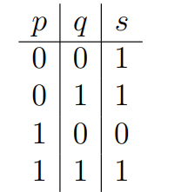

The expression associated with each row of the truth table – a conjunction of variables or their negations – is called a minterm.
The compound statement derived using the process consists of the disjunction of a collection of minterms (that is, they are all joined together using “or”).
It is called the disjunctive normal form of the statement s.

Slide 24
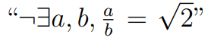
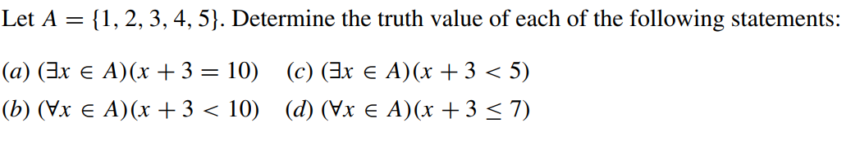
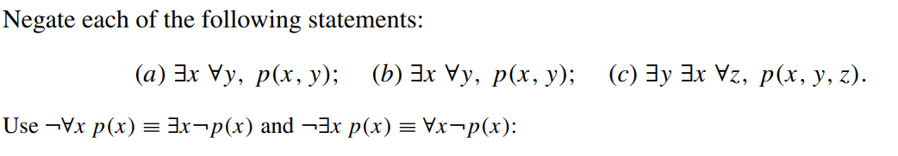
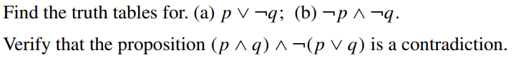
Try Exercise:
Express in words
2.
3.
4.

Slide 25
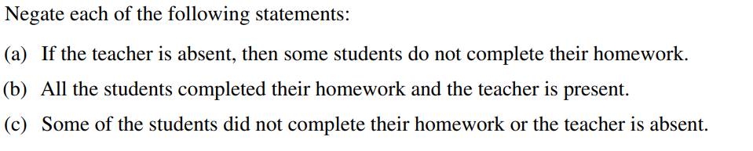
5.

Slide 26
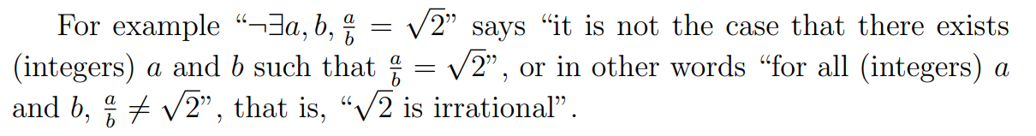
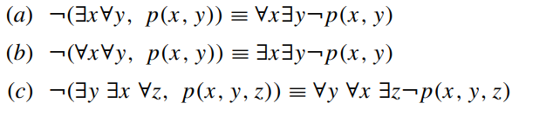
Answers:
1.
2. (a) False. For no number in A is a solution to x + 3 = 10. (b) True. For every number in A satisfies x + 3 < 10. (c) True. For if x0 = 1, then x0 + 3 < 5, i.e., 1 is a solution. (d) False. For if x0 = 5, then x0 + 3 is not less than or equal 7. In other words, 5 is not a solution to the given condition.
3.
5. (a) The teacher is absent and all the students completed their homework. (b) Some of the students did not complete their homework or the teacher is absent. (c) All the students completed their homework and the teacher is present.

Slide 27


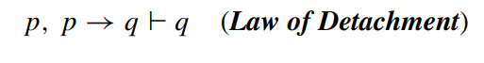
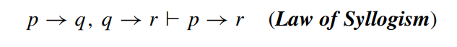
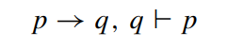
ARGUMENTS
An argument is an assertion that a given set of propositions P1, P2,...,Pn, called premises, yields (has a consequence) another proposition Q, called the conclusion. Such an argument is denoted by
The notion of a “logical argument” or “valid argument” is formalized as follows:
An argument is said to be valid if Q is true whenever all the premises P1, P2,...,Pn are true. An argument which is not valid is called fallacy.
The following argument is valid:
The following argument is a fallacy:

Slide 28
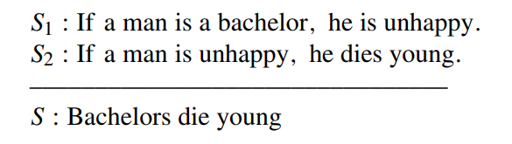

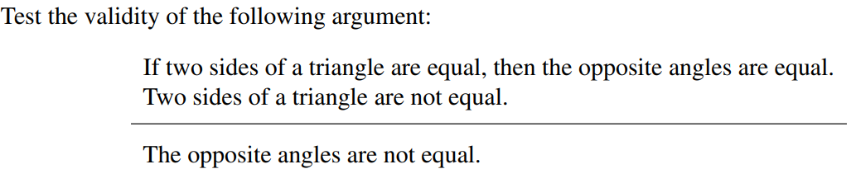

Consider the following argument:

Slide 29
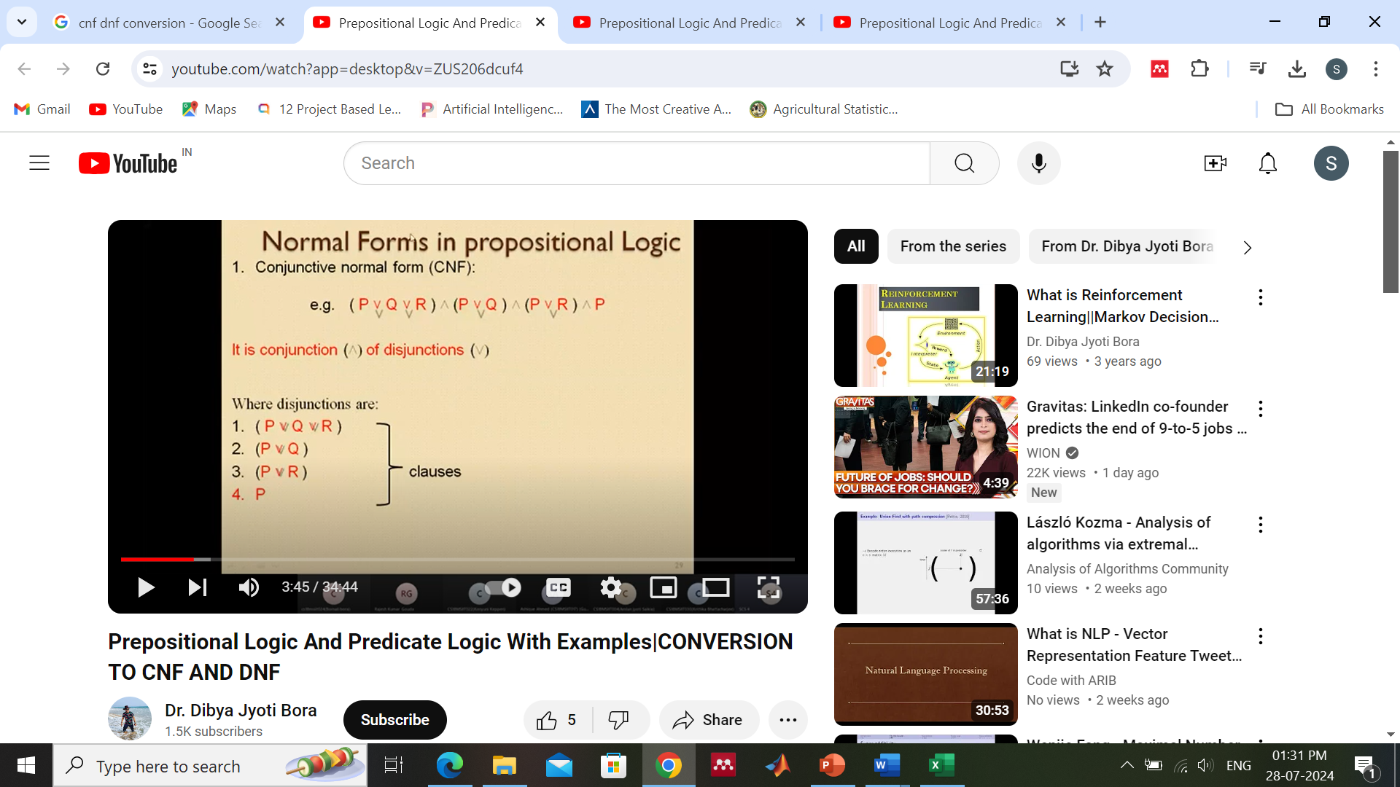


Slide 30

Procedure to convert a Statement to CNF

Slide 31


Slide 32
Convert to CNF
2.( p → q ) ˄ ( q ˅ ( p ˄ r ))
≡(∼p ˅ q ) ˄ ( q ˅ ( p ˄ r ))
≡ (∼ p ˅ q ) ˄ ( q ˅ p) ˄ ( q ˅ r)
Convert to DNF
p ˄ (p → q ) ≡ p ˄ (∼p ˅ q )
≡ (p ˄ ∼p) ˅ (p ˄ q)
2. (p → q ) ˄ (∼p ˄ q) ≡ (∼p ˅ q ) ˄ (∼p ˄ q)
≡ (∼p ˄(∼p ˄ q) ) ˅ ( q ˄(∼p ˄ q))
≡ (∼p ˄ q) ˅ (∼p ˄ q)

Slide 33
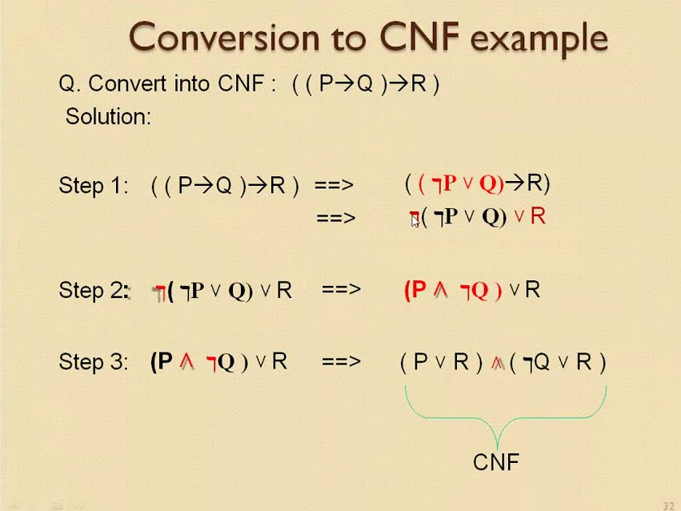

Slide 34

Mathematical Induction
the statement to be proved can be put in the form
We wish to show that P(n) is true for all integers n ≥ n0.
The following result shows how this can be done.
Suppose that (a) P(n0) is true and (b) If P(k) is true
for some k ≥ n0, then P(k + 1) must also be true. Then P(n) is true for all n ≥ n0.
This result is called the principle of mathematical induction.
Thus to prove the truth of a statement ∀n ≥ n0 P(n), using the principle of mathematical induction,
Begin by proving directly that the first proposition P(n0) is true. This is called the basis step of the induction.
Prove that P(k) ⇒ P(k + 1) is a tautology for any choice of k ≥ n0.

Slide 35
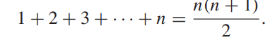
Show, by mathematical induction, that
for all n ≥ 1,
Solution: Let P(n) be the predicate 1+2+3+···+n = n(n + 1) 2 .
In this example, n0 = 1.
Basis Step We must first show that P(1) is true. P(1) is the statement 1 = 1(1 + 1) 2 , which is clearly true.

Slide 36
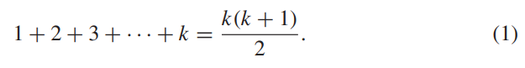
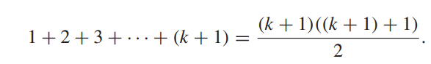
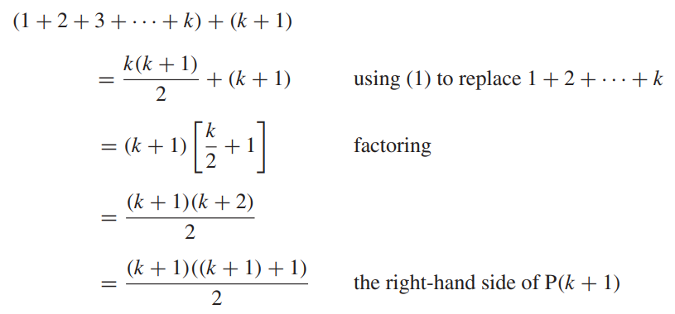
Induction Step We must now show that for k ≥ 1, if P(k) is true, then P(k + 1) must also be true. We assume that for some fixed k ≥ 1,
We now wish to show the truth of P(k + 1):
The left-hand side of P(k + 1) can be written as 1 + 2 + 3 +···+ k + (k + 1) and we have

Slide 37
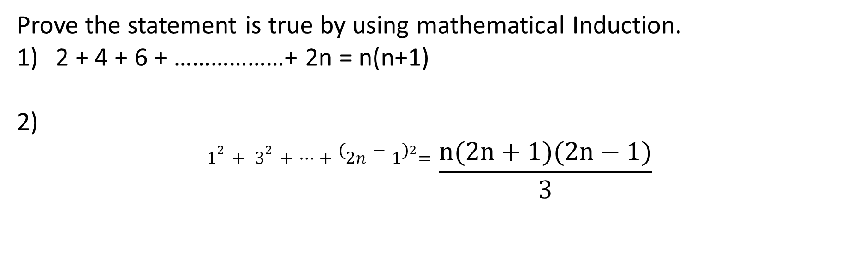
Prove the statement is true by using mathematical Induction.
2 + 4 + 6 + ………………+ 2n = n(n+1)
2)
$$1^{2}+ 3^{2}+…+{(2n−1)}^{2}=\frac{n(2n+1)(2n−1)}{3}$$

